Slide 1
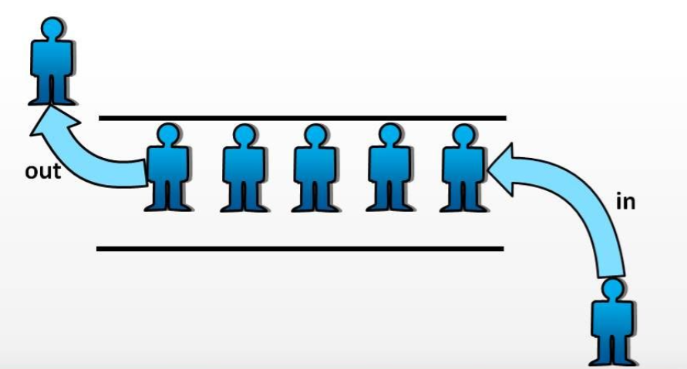

Slide 2
Queue
Mohammad Shahid Qureshi

Slide 3
Queue Data Structure
The queue data structure implements the well known queue concept present in our daily life, e.g., queue at bank
Dealing with data, we sometimes want to create queues of data to know which data came first.

Slide 4
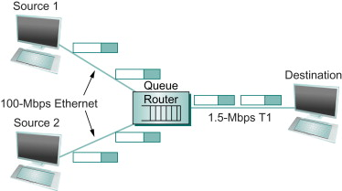
Need for Queues for data
Communication Software
  queues to hold information(packets) received over internet links on routers/computers. (Information is received faster than it can be processed, so is placed in a queue waiting to be processed)
Operating system
  multi-user/multitasking environments, where several users or task may be requesting the same resource simultaneously.

Slide 5
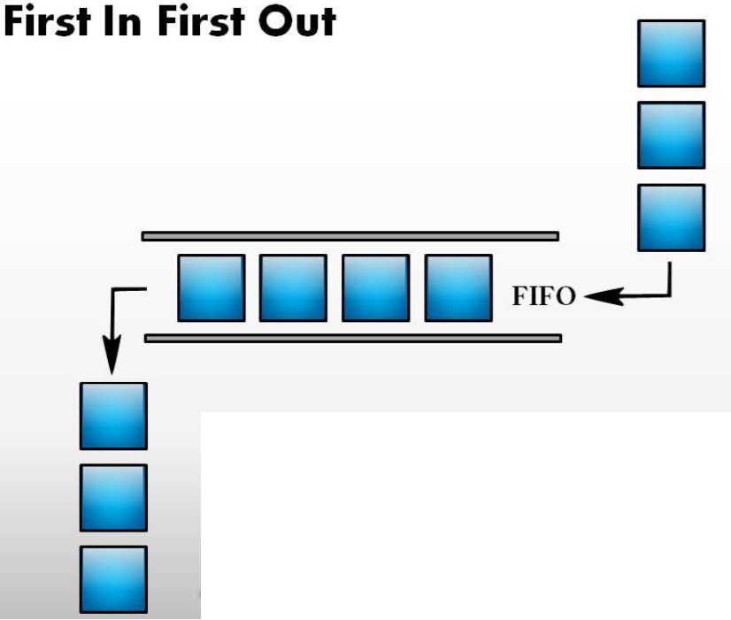
Queue
“A Queue is a linear data structure, where items are inserted at one end (the rear) And deleted at the other end (the front)”
Other Name:
First In First Out (FIFO)

Slide 6
Common Operations on Queues
(Queue ADT)
PUSH(x): Inserts element x at the end of Queue
POP(): Deletes the first element of the Queue
FRONT(): Returns the first element on Queue
ISEMPTY(): Returns true if its an empty queue.

Slide 7
Implementation
Array based
  Queue can be implemented by an array, and size of queue remains fix
Link List based
  A queue can be implemented as a linked list, and expand or shrink with each push or pop operation.

Slide 8
A pointer Implementation of Queues
Keep two pointers:
FRONT: A pointer to the first element of the queue.
REAR: A pointer to the last element of the queue.
.
Front
x
y
z
Rear

Slide 9
A pointer Implementation of Queues
Q.Front = NULL
Q.Rear = NULL
PUSH(x)
x
.
Q.front
Q.Rear

Slide 10
A pointer Implementation of Queues
PUSH(y)
x
y
.
Q.front
Q.Rear
POP()
y
.
Q.front
Q.Rear

Slide 11
A class for Dynamic Queue implementation
class DynIntQueue
{
private:
struct QueueNode
{
int info;
QueueNode *link;
};
QueueNode *front;
QueueNode *rear;
int numItems;
public:
DynIntQueue(void);
~DynIntQueue(void);
void push(int);
void pop(void);
int front();
bool isEmpty(void);
void makeNull(void);
};

Slide 12
Implemenaton
//************************
// Constructor *
//************************
DynIntQueue::DynIntQueue(void)
{
front = NULL;
rear = NULL;
numItems = 0;
}
//************************
// Destructor *
//************************
DynIntQueue::~DynIntQueue(void)
{
makeNull();
}

Slide 13
//********************************************
// Function enqueue inserts the value in num *
// at the rear of the queue. *
//********************************************
void DynIntQueue::push(int num)
{
QueueNode *newNode;
newNode = new QueueNode;
newNode->info = num;
newNode->link = NULL;
if (isEmpty())
{
front = newNode;
rear = newNode;
}
else
{
rear->link = newNode;
rear = newNode;
}
numItems++;
}

Slide 14
//**********************************************
// Function dequeue removes the value at the *
// front of the queue *
//**********************************************
void DynIntQueue::pop(void)
{
QueueNode *temp;
if (isEmpty())
cout << "The queue is empty.\n";
else
{
temp = front->link;
delete front;
front = temp;
numItems--;
}
}

Slide 15
//*********************************************
// Function isEmpty returns true if the queue *
// is empty, and false otherwise. *
//*********************************************
bool DynIntQueue::isEmpty(void)
{
if (numItems)
return false;
else
return true;
}
int DynIntQueue::front(void)
{
if (!isEmpty())
return front->info;
else
cout<<“Queue Empty”;
}

Slide 16
//********************************************
// Function makeNull dequeues all the elements *
// in the queue. *
//********************************************
void DynIntQueue::makeNull(void)
{
while(!isEmpty())
pop();
}

Slide 17
Int main()
{
DynIntQueue Q;
Q.push(45);
Q.push(55);
Q.push(65);
cout<<Q.front();
Q.pop();
Cout<<Q.front();
Q.pop();
Cout<<Q.front();

Slide 18
Program
// This program demonstrates the DynIntQeue class
void main(void)
{
DynIntQueue iQueue;
cout << “Pushing 5 items...\n";
// Push 5 items.
for (int x = 0; x < 5; x++)
iQueue.push(x);
// pop and retrieve all items in the queue
cout << "The values in the queue were:\n";
while (!iQueue.isEmpty())
{
int value;
value =iQueue.front();
cout << value << endl;
iQueue.pop();
}
}

Slide 19
Program Ouput
Pushing 5 items...
The values in the queue were:
0
1
2
3
4

Slide 20
Template Queue
The previous example of IntegerQueue can be easily converted into a template Queue, thus any kind of data can be stored in such a Queue.

Slide 21
Priority Queue
A priority queue allows entries to be retrieved according to some specified priority levels.
  The highest priority entry is removed first
  Entries with equal priority can be removed according to FIFO as queue.

Slide 22
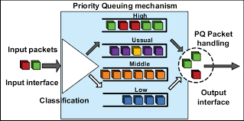
One of the priority Queue implementation technique

Slide 23
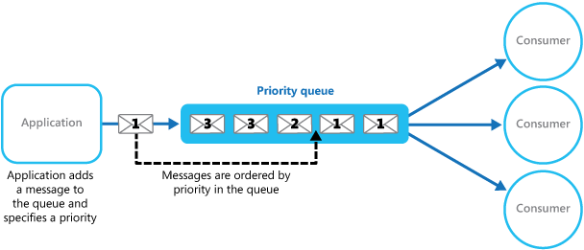
Another technique

Slide 24
Reference
Chapter 8 – Queues
Push is named as addQueue()
Pop is named as deleteQueue()
There is also back() function in addition to the front() function

Slide 25
Copy constructor and Assignment Operator overloading
Its as exercise for you to implement them

